Slide 1
BIA 650
Optimization and Process Analytics
6 – Integer programming
Integer Programming Introduction
Branch and Bound Technique
Assignment Problem
Sample 0-1 Linear Programming Problem
W&A Case 6.1 Mixed Integer Programing (MIP)
© E. A. Stohr, 2017
Notes:
Up to this point, we have been concerned with choosing & designing business processes.
In this lecture, we look at:
Simulation: How to check alternative process designs
WFMS: How to automate processes
Since not all processes can be expressed as fixed workflows, we also look at:
Groupware: How to support coordination in unstructured situations
Finally, we look at 2 real case studies involving the implementation of a WFMS

Slide 2
Integer Programming
Integer Programming (IP) involves solving optimization problems where some or all of the variables are constrained to be integer. In mixed integer programming some variables can be continuous and others integer. Many IPs have (0,1) constraints on the variable corresponding to cases where discrete choices have to be made (e.g., either one invests in a project or not.)
IP is computationally complex. For example if we have 10 variables and 10 possible integer values each, this means we have 10¹⁰ possible solution values!
Unfortunately rounding up or down optimal values from an optimal LP relaxation can be very misleading.
https://longitudes.ups.com/jack-levis/
© E. A. Stohr, 2013

Slide 3
Branch & Bound
Branch and Bound (B&B) provides an efficient, divide and conquer, method to avoid enumerating all possible solutions and yet still find an optimal result. This often involves solving multiple LPs with an additional constraint at each iteration.
Implicit enumeration examines only a fraction of all (say) 10¹⁰ potential solutions and guarantees that solutions not examined have no chance of being optimal.
General idea of the branch and bound method used by Solver in IP models:
  Branching means that the algorithm systematically searches through the set of all feasible integer solutions, creating branches, or subsets, of solutions as it goes.

Slide 4
Branch and bound (ctd.)
  Bounding. Every time the best feasible solution is found, it is called the incumbent solution – the best so far. The solution represents a lower bound on the optimal solution (for a maximize objective).
  Finding the upper bound depends on the problem and algorithmic approach.
  If the upper bound (infeasible) is higher than the incumbent feasible solution then feasible solutions derived from that upper bound are worth exploring, and the branching process is continued.

Slide 5
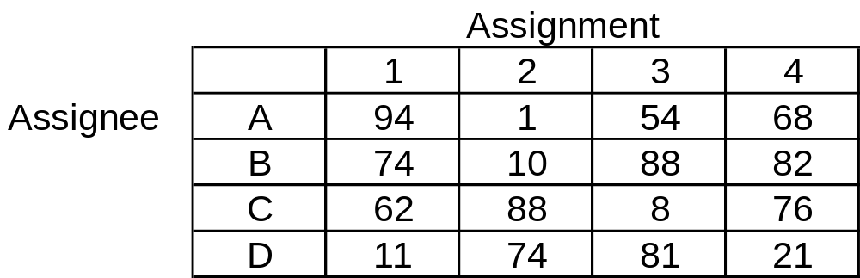
B&B for the Assignment Problem
The objective is to assign each assignee (e.g., person) to one and only one assignment (e.g., task) to minimize the sum of the cost of the assignments.
Note – if A is assigned to 1, then there are 3! or 6 ways to assign the other 3 assignees to assignments. Overall, the are 4! = 24 possible feasible solutions. This is a small problem!

Slide 6
Assignment Problem Example
Determining Lower Bounds
Summing the minimum of the numbers in each column gives a lower bound on the solution. In this case, 41 is a lower bound. However, this solution is not feasible, Why?
Let’s assign A to 1, Eliminating row 1 and column 1, the minima in each column are: 10, 8 and 21. This gives a lower bound corresponding to assignments:
B->10, C->3, D->4
Hence the lower bound with A-1 is 94 + 39 = 133, (which is feasible)

Slide 7
Assignment (ctd.)
Lower bounds on assignments to 1
  A-1 = 133 (feasible)
  B-1 = 104 (feasible)
  C-1 = 138 (infeasible)
  D-1 = 88 (infeasible)

Slide 8
Assignment Problem
41
A-1
B-1
C-1
D-1
Optimal solution is
< 104 and > 88
133
104
138
88
Feasible
Feasible
A-2
B-2
C-2
Optimal solution is
< 97 and > 96
96
97
221
Feasible
B-3
C-3
Optimal solution is
< 97 and > 97
Optimal Solution
D-1= 11
B-2= 10
C-3= 8
A-4 = 68
Total = 97
176
102
Feasible
Feasible

Slide 9
Branch & Bound Ideas
The basic concept underlying the branch-and-bound technique
is to divide and conquer.
Since the original “large” problem is hard to solve directly,
it is divided into smaller and smaller subproblems
until these subproblems can be conquered.
The dividing (branching) is done by partitioning
the entire set of feasible solutions into smaller and smaller subsets.
The fathoming (conquering) is done partially by
(i) giving a bound for the best solution in the subset;
(ii) discarding the subset if the bound indicates that
it can’t contain an optimal solution.
These three basic steps – branching, bounding, and fathoming –
are illustrated on the following example.
Based on: www.ohio.edu/people/melkonia/math443/slides/bb1.pp
© E. A. Stohr, 2012

Slide 10
Example of Branch-and-Bound
6
Max Z = 5x₁ + 8x₂
s.t. x₁ + x₂ ≤ 6
5x₁ + 9x₂ ≤ 45
x₁ , x₂ ≥ 0 integer
_{LP RELAXATION}
x₁ + x₂ = 6
X2
5
4
(2.25, 3.75)
3
Z=41.25
2
5x₁ + 9x₂ = 45
1
Z=20
0
1
2
3
4
5
7
8
6
X1
© E. A. Stohr, 2012

Slide 11
Utilizing the information about the optimal solution of the LP-relaxation
Fact: If LP-relaxation has integral optimal solution x*, then x* is optimal for IP too.
In our case, (x₁, x₂) = (2.25, 3.75) is the optimal solution of the LP-relaxation. But, unfortunately, it is not integral.
The optimal value of the relaxed problem is 41.25 .
Fact: OPT(LP-relaxation) ≥ OPT(IP)
(for maximization problems)
That is, the optimal value of the LP-relaxation
is an upper bound
for the optimal value of the integer program.
In our case, 41.25 is an upper bound for OPT(IP).
© E. A. Stohr, 2012

Slide 12
Branching Step
In an attempt to find out more
about the location of the IP’s optimal solution,
partition the feasible region of the LP-relaxation.
Choose a variable that is fractional in the optimal solution to the LP-relaxation – say, x₂ . Observe that every feasible IP point must have either x₂ ≤ 3 or x₂ ≥ 4 .
With this in mind, branch on the variable x₂ to create the following two subproblems:
Subproblem 1 Subproblem 2
Max Z = 5x₁ + 8x₂ Max Z = 5x₁ + 8x₂
s.t. x₁ + x₂ ≤ 6 s.t. x₁ + x₂ ≤ 6
5x₁ + 9x₂ ≤ 45 5x₁ + 9x₂ ≤ 45
x₂ ≤ 3 x₂ ≥ 4
x₁ , x₂ ≥ 0 x₁ , x₂ ≥ 0
Solve both subproblems
(note that the original optimal solution (2.25, 3.75) can’t recur)
© E. A. Stohr, 2012

Slide 13
Branching step (graphically)
Subproblem 1: Opt. solution (3,3) with value 39
Subproblem 2: Opt. solution (1.8,4) with value 41
X2
5
Z=41
Subproblem 2
4
(1.8, 4)
3
(3, 3)
Z=39
2
Subproblem 1
1
Z=20
0
1
2
3
4
5
7
8
6
X1
© E. A. Stohr, 2012

Slide 14
Solution Tree to Date
S1: x₂ ≤ 3
(3, 3)
Z=39
For each subproblem, we record
the restriction that creates the subproblem
the optimal LP solution
the LP optimum value
The optimal solution for Subproblem 1 is integral: (3, 3).
If further branching on a subproblem will yield no useful information, then we can fathom (dismiss) the subproblem.
In our case, we can fathom Subproblem 1 because its solution is integral.
The best integer solution found so far is stored as incumbent. The value of the incumbent is denoted by Z*.
In our case, the first incumbent is (3, 3), and Z*=39.
Z* is a lower bound for OPT(IP): OPT(IP) ≥ Z* .
In our case, OPT(IP) ≥ 39. The new upper bound is 41: OPT(IP) ≤ 41.
int.
All
(2.25, 3.75)
Z=41.25
S2: x₂ ≥ 4
(1.8, 4)
Z=41
© E. A. Stohr, 2012

Slide 15
Next branching step (graphically)
- Fathom Subproblem 1.
- Branch Subproblem 2 on x₁ :
Subproblem 3: New restriction is x₁ ≤ 1.
Opt. solution (1, 4.44) with value 40.55
Subproblem 4: New restriction is x₁ ≥ 2.
The subproblem is infeasible
[ x2 > 4 in S2 subproblem ]
X2
Subpr. 3
Subpr. 4
5
(1, 4.44)
4
3
Z=40.55
2
1
Z=20
0
1
2
3
4
5
7
8
6
X1
© E. A. Stohr, 2012

Slide 16
Solution tree (cont.)
S1: x₂ ≤ 3
(3, 3)
Z=39
int.
If a subproblem is infeasible, then it is fathomed.
In our case, Subproblem 4 is infeasible; fathom it.
The upper bound for OPT(IP) is updated: 39 ≤ OPT(IP) ≤ 40.55 .
Next branch Subproblem 3 on x₂ .
(Note that the branching variable might recur).
All
(2.25, 3.75)
Z=41.25
S3: x₁ ≤ 1
(1, 4.44)
Z=40.55
S2: x₂ ≥ 4
(1.8, 4)
Z=41
S4: x₁ ≥ 2
infeasible
© E. A. Stohr, 2012

Slide 17
Next branching step (graphically)
Branch Subproblem 3 on x₂ :
Subproblem 5: New restriction is x₂ ≤ 4.
Feasible region:
the segment joining (0,4) and (1,4)
Opt. solution (1, 4) with value 37
Subproblem 6: New restriction is x₂ ≥ 5.
Feasible region is just one point: (0, 5)
Opt. solution (0, 5) with value 40
X2
(0, 5)
5
4
(1, 4)
3
2
1
Z=20
0
1
2
3
4
5
7
8
6
X1
© E. A. Stohr, 2012

Slide 18
Solution tree (final)
If the optimal value of a subproblem is ≤ Z*, then it is fathomed.
  In our case, Subproblem 5 is fathomed because 37 ≤ 39 = Z*.
If a subproblem has integral optimal solution x*,
and its value > Z*, then x* replaces the current incumbent.
  In our case, Subproblem 5 has integral optimal solution, and its value 40>39=Z*. Thus, (0,5) is the new incumbent, and new Z*=40.
If there are no unfathomed subproblems left, then the current incumbent is an optimal solution for (IP).
  In our case, (0, 5) is an optimal solution with optimal value 40.
S1: x₂ ≤ 3
(3, 3)
Z=39
int.
S5: x₂ ≤ 4
(1, 4)
Z=37
int.
All
(2.25, 3.75)
Z=41.25
S3: x₁ ≤ 1
(1, 4.44)
Z=40.55
S2: x₂ ≥ 4
(1.8, 4)
Z=41
S6: x₂ ≥ 5
(0, 5)
Z=40
int.
S4: x₁ ≥ 2
infeasible
© E. A. Stohr, 2012

Slide 19
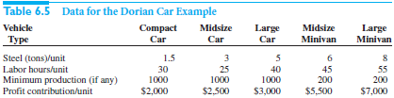
Example 6.3: Dorian Auto
Dorian Auto is considering manufacturing three types of cars (compact, midsize, and large) and two types of minivans (midsize and large).
The resources required and the profits yielded by each type of vehicle are shown in this table.
Use a binary model to decide which types of vehicles to produce (above minimal requirements) and in what quantities to maximize profits.

Slide 20
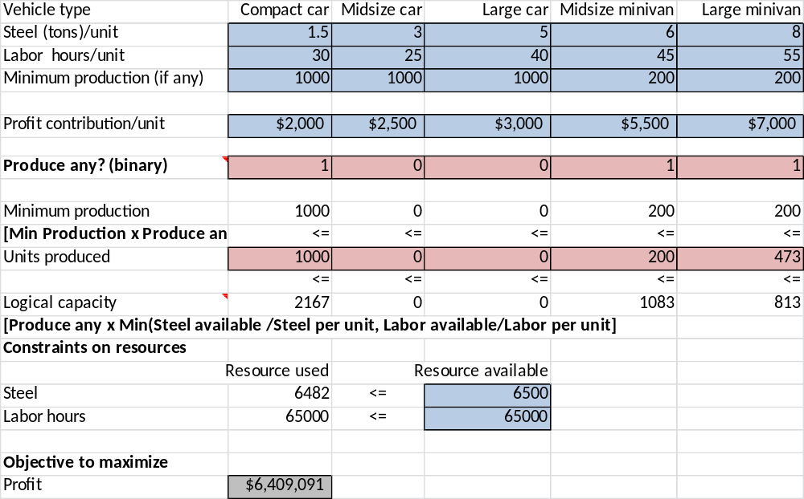
Example 6.3- either/or constraints

Slide 21
Case 6.1 Giant Motor Company
Mixed Integer Programming (MIP)
GMC produces Lyra, Libra and Hydra (luxury) in 3 dedicated plants
Strategic decision: Whether or not to build new more flexible plants for Lyra and Libra (replacing the old factories).
Assumptions
The Lyra and/or Libra plants can be retooled
The Hydra plant must stay open and cannot be retooled
There is no incentive to produce more than estimated demand
Upward cross-selling is possible (e.g., a portion of any excess demand for Lyras can be converted to purchases of Libra of Hydras)

Slide 22
Mixed Integer Programming (MIP)
Data is in top part of solution spreadsheet
W&A Case 6.1 GMC I
Step 1: Scale the data
Plant Characteristics | Lyra | Libra | Hydra | New Lyra | New Libra
Capacity (in millions) | 1 | 0.8 | 0.9 | 1.6 | 1.8
Fixed cost (in $millions) | 2 | 2 | 2.6 | 3.4 | 3.7
Profit Margins ($1,000s per car)
Step 2: Identify Decision Variables
Car | Lyra | Libra | Hydra | New Lyra | New Libra
Lyra | 2 |  |  | 2.5 | 2.3
Libra |  | 3 |  | 3 | 3.5
Hydra |  |  | 5 |  | 4.8
Car | Lyra | Libra | Hydra | New Lyra | New Libra
Lyra | Y |  |  | Y_{RLY} | Y_{RLI}
Libra |  | I |  | I_{RLY} | I_{RLI}
Hydra |  |  | H |  | H_{RLI}
X-Sell Excess Demand (from row to column)
Demand (in millions)
Lyra | 1.4
Libra | 1.1
Hydra | 0.8
Car | Lyra | Libra | Hydra
Lyra |  | 0.3 | 0.05
Libra | 0 |  | 0.1
Hydra | 0 | 0

Slide 23
GMC Model II
Bottom part of solution spreadsheet
Decisions on retooling (binary variables)
Retool Lyra? | 1 |  |  |  | =B21+C26*(I39-G39)
Retool Libra? | 0
Resulting plants open | Lyra | Libra | Hydra | New Lyra | New Libra
 | 0 | 1 | 1 | 1 | 0
Production(in millions) | Lyra | Libra | Hydra | New Lyra | New Libra | Total |  | Demand
Lyra | 0 | 0 | 0 | 1.257 | 0 | 1.257 | <= | 1.4
Libra | 0 | 0.8 | 0 | 0.343 | 0 | 1.143 | <= | 1.143
Hydra | 0 | 0 | 0.807 | 0 | 0 | 0.807 | <= | 0.807
Total | 0 | 0.8 | 0.807 | 1.6 | 0
=1-B2 | <= | <= | <= | <= | <=
Logical upper bound | 0 | 0.8 | 0.9 | 1.6 | 0
Cost summary (in $billions) | Lyra | Libra | Hydra | New Lyra | New Libra | Totals
Gross profit | 0 | 2.4 | 4.036 | 4.171 | 0 | 10.607
Fixed costs | 0 | 2 | 2.6 | 3.4 | 0 | 8
Net profit | 2.607

Slide 24
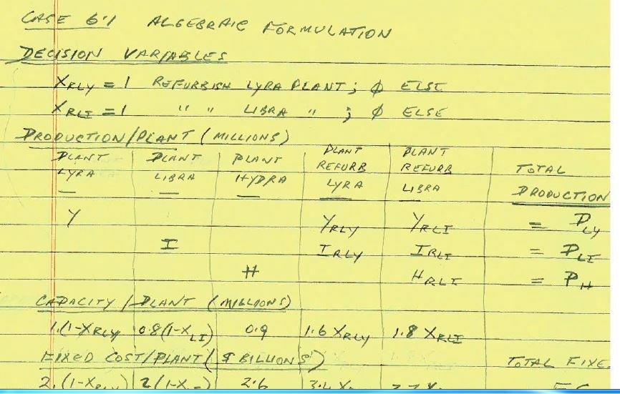
Case 6.1 Algebraic I

Slide 25
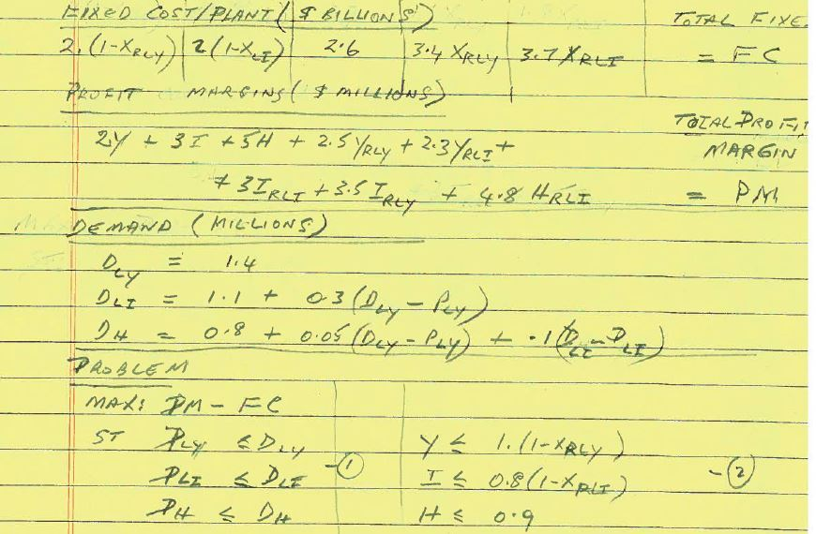
Case 6.1 Algebraic II

Slide 26
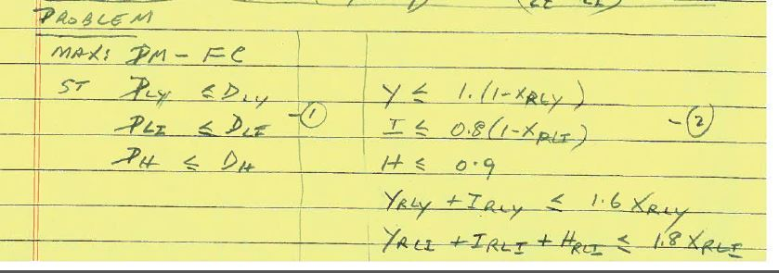
Case 6.1 Algebraic Final Model

Slide 27
© E. A. Stohr, 2012

Slide 28
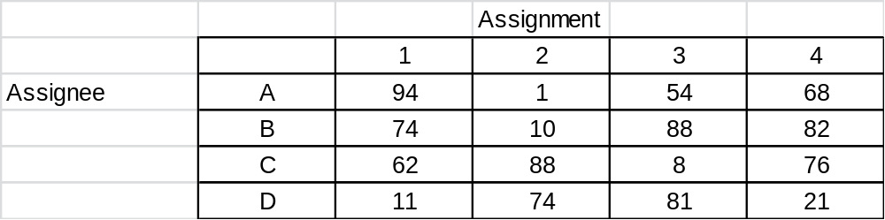
In-class Exercise - Assignment
Complete the next level in the implicit enumeration tree:

Slide 29
B&B Example
MaxZ = −x1 + 4x2
s. t. −10x1 +20x2 ≤ 22
5x1 +10x2 ≤ 49
x1 ≤ 5, xi ≥ 0
Optimal solution of the relaxation is (3.8, 3) with z = 8.2. Then we consider two cases: x1 ≥ 4 and x1 ≤ 3.
−10x1 +20x2 = 22
-1 0 1 2 3 4 5 6
4
3
2
1
0

Slide 30
B&B Example
− 10x1 +20x2 ≤ 22
5x1 +10x2 ≤ 49
x1 ≤ 5
x1 ≥ 4
x2 ≥ 0
has optimal solution at (4, 2.9) with Z = 7.6.

Slide 31
B&B Example
The linear programming relaxation
Max Z = −x1 +4x2
s.t. − 10x1 +20x2 ≤ 22
5x1 +10x2 ≤ 49
4 ≤ x1 ≤ 5
x2 ≥ 3
has no feasible solution (5x1 +10x2 ≥ 50) so the IP has no feasible solution either.

Slide 32
B&B Example
The linear programming relaxation
Max Z = −x1 +4x2
s.t. − 10x1 +20x2 ≤ 22
5x1 +10x2 ≤ 49
4 ≤ x1 ≤ 5
0 ≤ x2 ≤ 2
has an optimal solution at (4, 2) with Z = 4.
This is the optimal solution of the IP as well. Currently, the best value of Z for the original IP is Z = 4.

Slide 33
B&B Example
Now we consider the branch of 0 ≤ x1 ≤ 3. The LP relaxation
Max Z = −x1 +4x2
s.t. − 10x1 +20x2 ≤ 22
5x1 +10x2 ≤ 49
x1 ≤ 3
0 ≤ xi
3
has an optimal solution at (3, 2.6) with Z = 7.4. We branch out further to two cases: x2 ≤ 2 and x2 ≥ 3.

Slide 34
B&B Example
The LP relaxation
Max Z = −x1 +4x2
s.t. − 10x1 +20x2 ≤ 22
5x1 +10x2 ≤ 49
2 ≤ x1 ≤ 3
0 ≤ x2 ≤ 2
has an optimal at (2, 2), with Z = 6. Since this is better than the incumbent Z = 4 at (4, 2), this new integer
solution is our current best solution.

Slide 35
B&B Example
Rule of Fathoming
A subproblem is fathomed
1. The relaxation of the subproblem has an optimal solution with z < z∗ where z∗ is the current best
solution;
2. The relaxation of the subproblem has no feasible solution;
3. The relaxation of the subproblem has an optimal solution that has all integer values (or all binary if it is an BIP).

